Slide 1
Radio Telescope Project
Supervised By:
Dr Iain Collings
Developed By:
Niroshan Rajadurai
Sujee Sivasubramaniyam
Thaya Thanabalasingham

Slide 2
Introduction
Initial Goals
  Integration of previous work
  Graphical User Interface
  Documentation
Modified Goals
  Port from UNOS to RT-Linux
Final Accomplishments

Slide 3
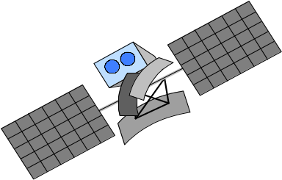
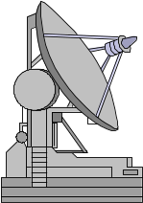

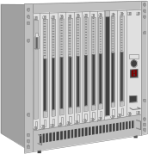

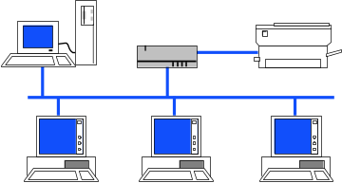


System Overview
Internet

Slide 4
Sequencer
“State machine - the brain of the dish.”
Functions
Arbitrate the modes of operation,
Carry out commands,
Check for safety conditions

Slide 5
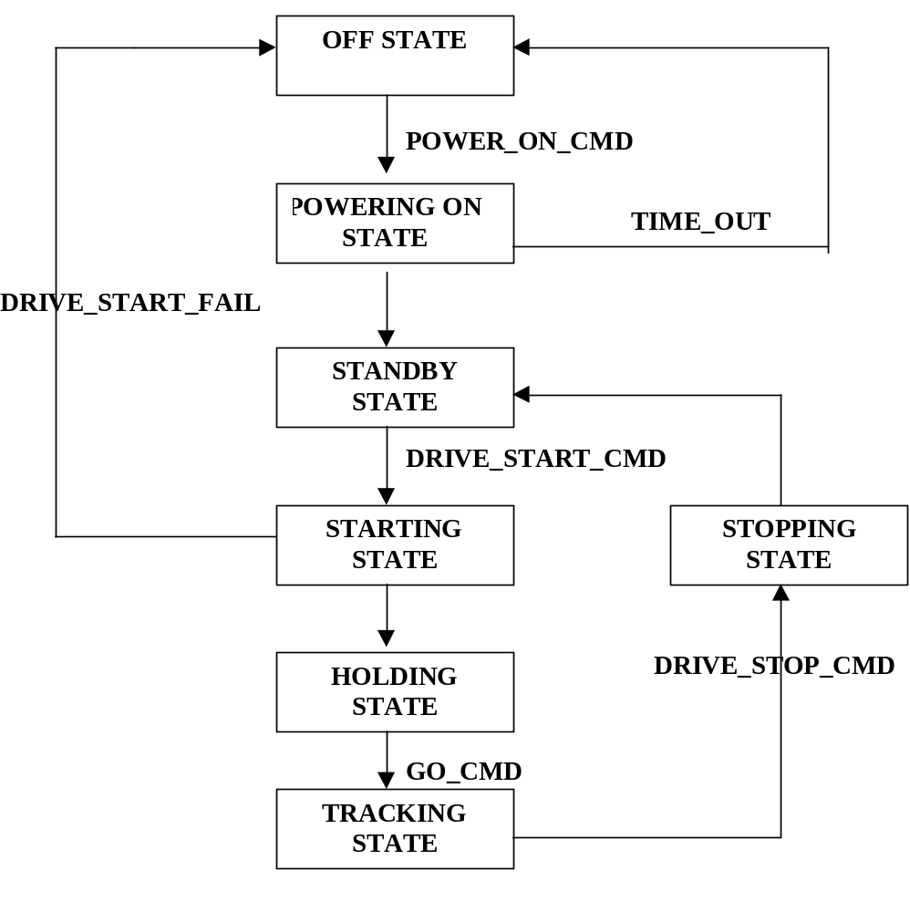

State Diagram

Slide 6

Sequencer
Modifications
Porting to Linux
Interface between Server & Sequencer
Performance
Cycle time vs cycle frequency
Interface between Server & Sequencer

Slide 7
Satellite Track
“Finding the satellite position with respect to the observer”
Problem
A non-stationary observer
Solution
Calculate satellite position an inertial system
Calculate the observer's position in the same system
Calculate the relative position of the satellite
Calculate Azimuth & Elevation

Slide 8
A Real Time Linux
“In a real-time system, the right result late is wrong”
Why Real Time Linux?
Hard-real time tasks, both periodic and interrupt driven
Access to all the tools and services available on UNIX platforms
Real-Time linux is a more powerful O/S than UNOS & QNX
Linux has a user base of approx. 7 mil, with good support (news grps, etc.)
Free, easy to install & up-grade

Slide 9
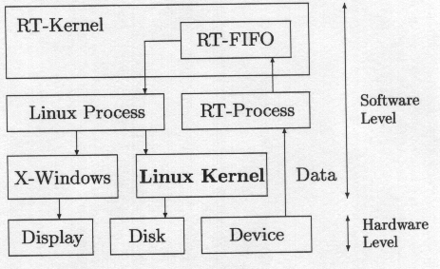
A Real Time Linux
System Overview

Slide 10
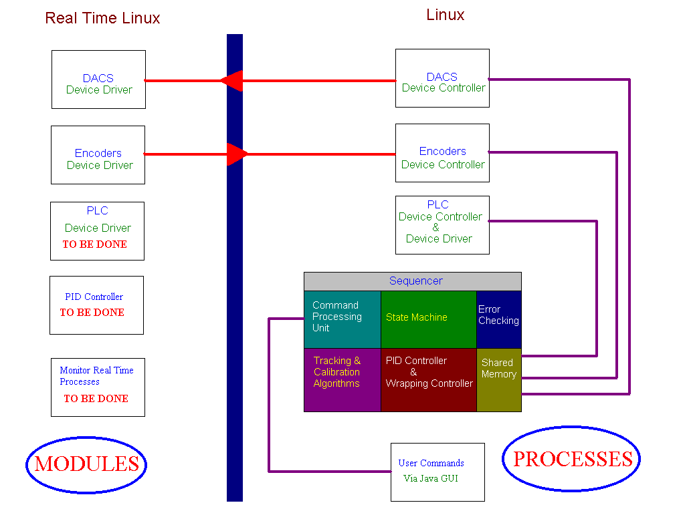

Real Time System

Slide 11
Device Drivers
PLC Driver
  RS-422 Serial driver (char devices)
  Used existing PLC driver
DACs , Encoders
  Converted DOS system calls to Linux

Slide 12
Stargate
On-line Documentation
Hardware Manuals
Source Code
Useful References
Search Engine
Official Home Page

Slide 13


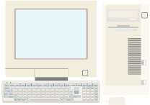
Java & Antenna
Overall System
Client
Stargate

Slide 14
Why Java?
Platform Independence
“Write Once Run Anywhere”
Built in Graphics
Very easy networking
Open standard
Slow??

Slide 15
Client Side
Design Goals
Object oriented
Small components (plugs in)
Light weight
Fast download
Easy & Intuitive to use
Works on most browsers
Minimal bandwidth consumption

Slide 16

Implementation
Used Java version 1.1 (not 1.0 or 1.2)
Used free 3rd party graphical software
Two kinds of networking (TCP/IP & UDP)
Screenshot

Slide 17
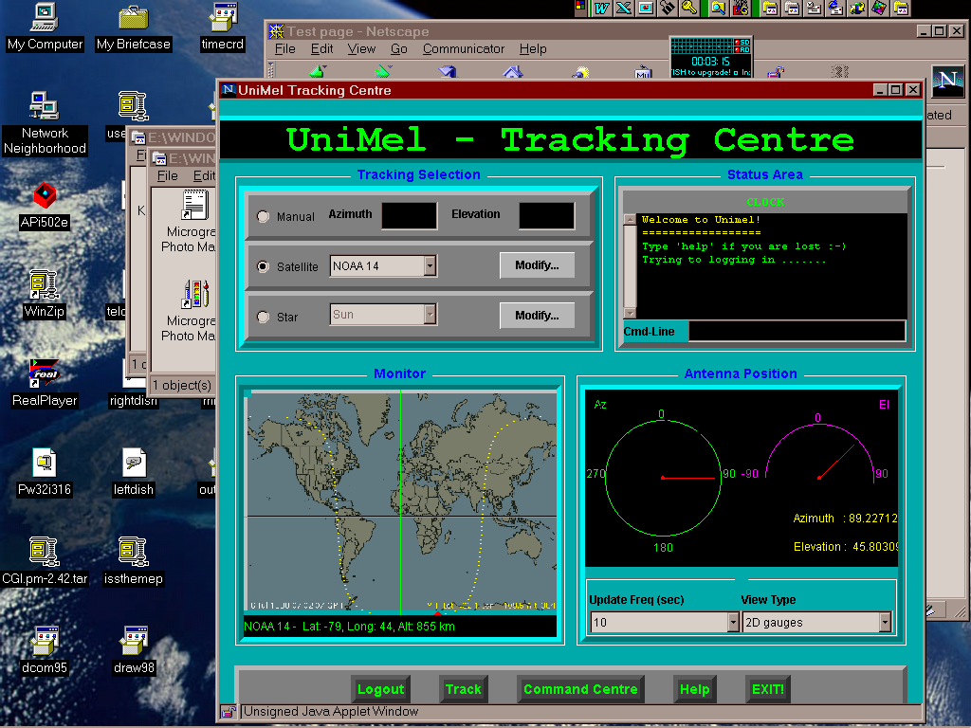

Slide 18
Main Server
Design Goals
• Robust & fast • Scalable
Implementation
• Java on Linux • Easy configuration
• Master/Slave • Pre forking (Apache)
Performance
+ Will scale up to 1000 clients

Slide 19
Tower Server
Design Goal :
Very light load on system
Implementation
• Java talks to C via Java Native Interface
• C functions passes date between Java & RT Linux
Performance
about 0.1 % CPU load and 1% memory

Slide 20
Conclusion
•Real Time Linux
- Stable, tested & fully functional
• Porting
- Sequencer, DACs, RS-422, Encoders, & PLC driver successfully ported, and stable
• Java
- Connects client to server reliably, tested on external networks (private ISPs)

Slide 21


Aren't Sunsets Beautiful?

